Slide 1
Module -2
Relational Model and E-R Modelling

Slide 2
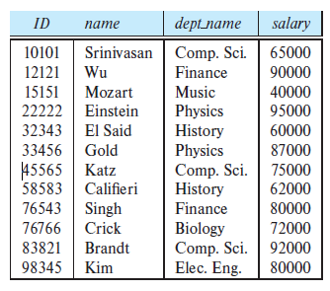

Structure of Relational Databases

Slide 3
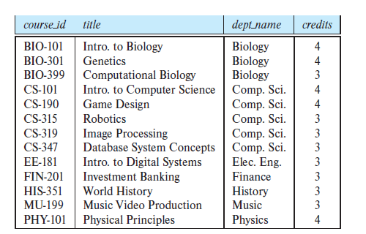
The course relation

Slide 4
student (ID, name, dept name, tot cred)
advisor (s id, i id)
takes (ID, course id, sec id, semester, year, grade)
classroom (building, room number, capacity)
time slot (time slot id, day, start time, end time)

Slide 5
Empid // unique & not null
Ename // duplicates
Emp aadhar // unique & Not null
Emp sal // duplicates
Emp contact // may have Null values
Emp email // may have Null values

Slide 6
Super key
A superkey is a set of one or more attributes that, taken collectively, allow us to identify uniquely a tuple in the relation.
For example, the ID attribute of the relation instructor is sufficient to distinguish one instructor tuple from another.
Thus, ID is a superkey.
The name attribute of instructor, on the other hand, is not a superkey, because several instructors might have the same name.

Slide 7
Candidate Keys
A superkey may contain extraneous attributes. For example, the combination of ID and name is a superkey for the relation instructor.
If K is a superkey, then so is any superset of K.
We are often interested in superkeys for which no proper subset is a superkey. Such minimal superkeys are called candidate keys.
Suppose that a combination of name and dept name is sufficient to distinguish among members of the instructor relation. Then, both {ID} and {name, dept name} are candidate keys.

Slide 8
Primary Key
We shall use the term primary key to denote a candidate key that is chosen by the database designer as the principal means of identifying tuples within a relation.
Any two individual tuples in the relation are prohibited from having the same value on the key attributes at the same time.
student (ID, name, dept name, tot cred)
classroom (building, room number, capacity)

Slide 9
Foreign Key
A foreign-key constraint from attribute(s) A of relation r1 to the primary-key B of relation r2 states that on any database instance, the value of A for each tuple in r1 must also be the value of B for some tuple in r2.
Attribute set A is called a foreign key from r1, referencing r2.

Slide 10
Alternate key
All the candidate key except the primary key
Unique key
As similar to Primary Key but it accepts NULL Values

Slide 11
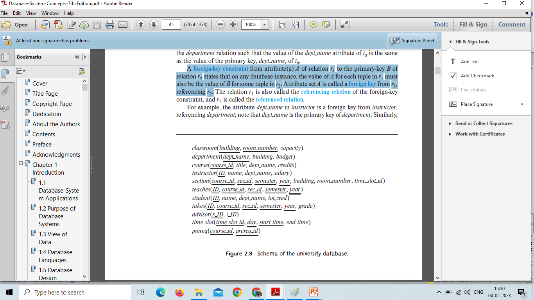
Schema

Slide 12
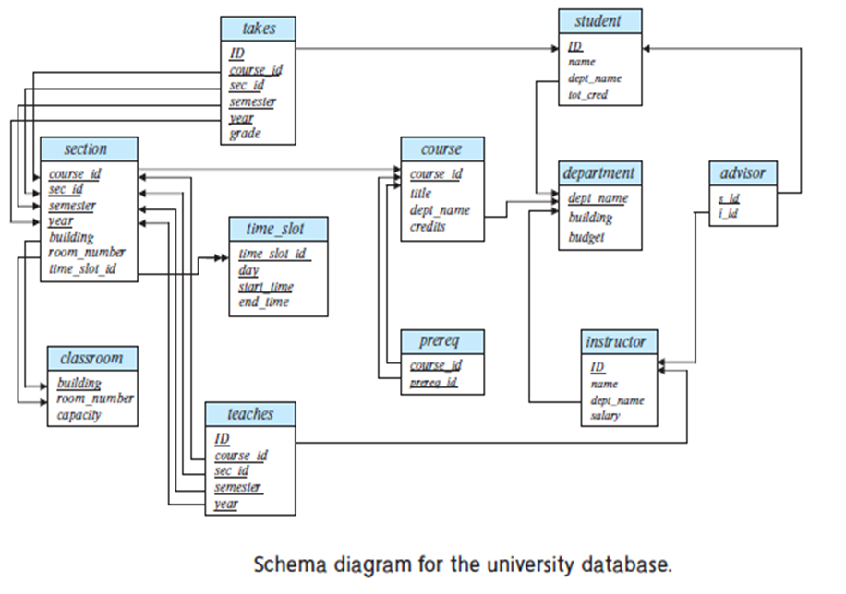

Slide 13
Constraints
we discuss the various restrictions on data that can be specified on a relational database in the form of constraints. Constraints on databases can generally be divided into three main categories:
Implicit constraints
Explicit constraints
Semantic constraints

Slide 14
Constraints that are inherent in the data model. We call these inherent model-based constraints or implicit constraints.
Constraints that can be directly expressed in schemas of the data model, typically by specifying them in the DDL. We call these schema-based constraints or explicit constraints.
Constraints that cannot be directly expressed in the schemas of the data model, and hence must be expressed and enforced by the application programs. We call these application-based or semantic constraints or business rules.

Slide 15
Another important category of constraints is data dependencies, which include functional dependencies and multivalued dependencies.
They are used mainly for testing the “goodness” of the design of a relational database and are utilized in a process called normalization

Slide 16
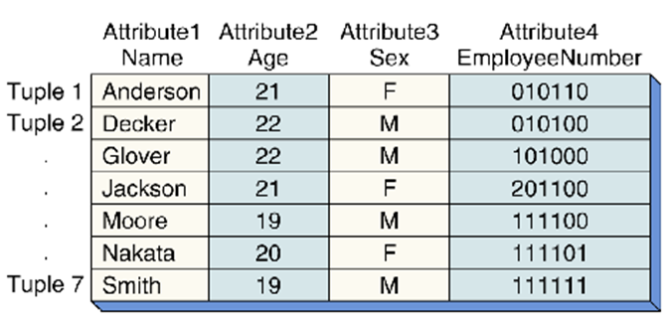
Functional dependency
A functional dependency (FD) is a relationship between two attributes, typically between the PK and other non-key attributes within a table.
For any relation R, attribute Y is functionally dependent on attribute X (usually the PK), if for every valid instance of X, that value of X uniquely determines the value of Y.
Relationship among or between attributes

Slide 17
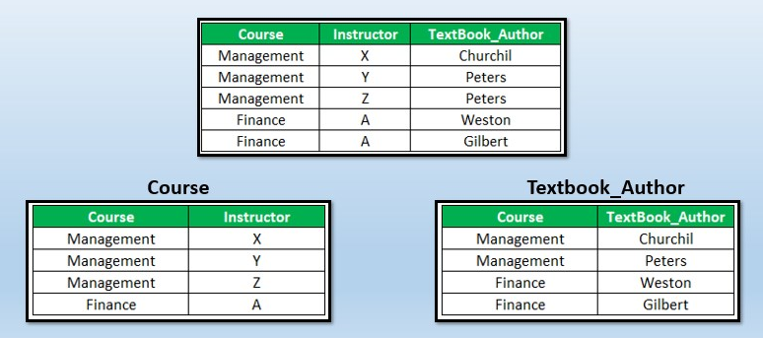
Multivalued dependency
Suppose there is a bike manufacturer company which produces two colors(white and black) of each model every year. Here columns COLOR and MANUF_YEAR are dependent on BIKE_MODEL and independent of each other. In this case, these two columns can be called as multivalued dependent on BIKE_MODEL.

Slide 18
The schema-based constraints include
Domain constraints,
Key constraints,
Constraints on NULLs,
Entity integrity constraints, and
Referential integrity constraints.

Slide 19
Domain Constraints
Domain constraints specify that within each tuple, the value of each attribute A must be an atomic value from the domain dom(A).
The data types associated with domains typically include standard numeric data types
for integers (such as short integer, integer, and long integer)
real numbers (float and double precision float). Characters, Booleans, fixed-length strings, and variable-length strings are also available
date, time, timestamp, and money, or other special data types also available.

Slide 20
Key Constraints
no two tuples can have the same combination of values for all their attributes.
Usually, there are other subsets of attributes of a relation schema R with the property that no two tuples in any relation state r of R should have the same combination of values for these attributes.
Candidate key (have more than one key )
Primary Key ( one key – Underlined )

Slide 21
Properties of Keys
Two distinct tuples in any state of the relation cannot have identical values for (all) the attributes in the key. This first property also applies to a superkey.
It is a minimal superkey—that is, a superkey from which we cannot remove any attributes and still have the uniqueness constraint in condition 1 hold. This property is not required by a superkey.

Slide 22
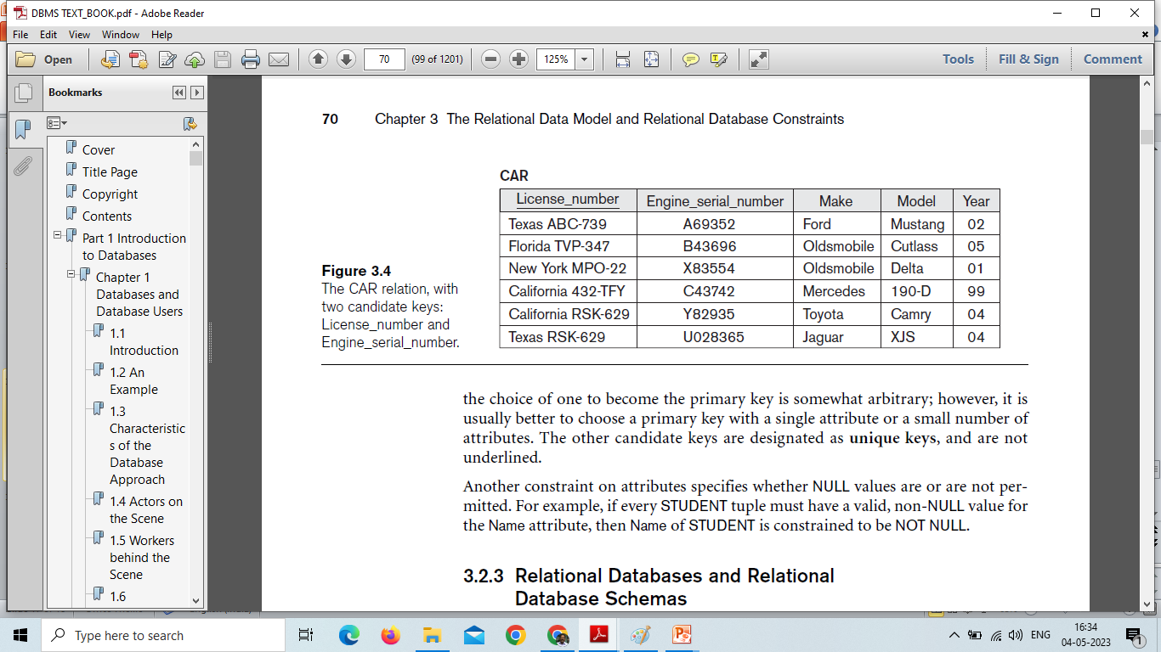
The car relation with two candidate keys : License_number, Engine_serial_number

Slide 23
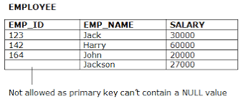
Entity integrity constraint
To identify each row in a table, the table must have a primary key. The primary key is a unique value that identifies each row. This requirement is called the entity integrity constraint .

Slide 24
Referential Integrity Constraint
A foreign key constraint (also referred to as a referential constraint or a referential integrity constraint) is a logical rule about values in one or more columns in one or more tables. For example, a set of tables shares information about a corporation's suppliers.

Slide 25
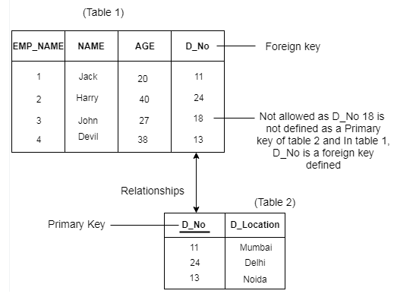

Slide 26
Not NULL
Another constraint on attributes specifies whether NULL values are or are not permitted.
For example, if every STUDENT tuple must have a valid, non-NULL value for the Name attribute, then Name of STUDENT is constrained to be NOT NULL.

Slide 27
Handling Null Values
One way of handling missing values is the deletion of the rows or columns having null values.
If any columns have more than half of the values as null then you can drop the entire column.
In the same way, rows can also be dropped if having one or more columns values as null.
Or You may fill by replacement of null values by meaningful values makes the table easier to interpret for readers

Slide 28
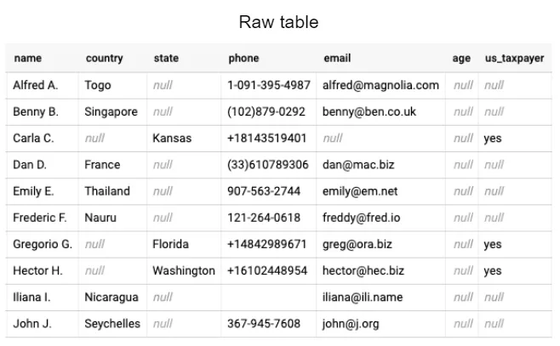

Slide 29
